Slide 1

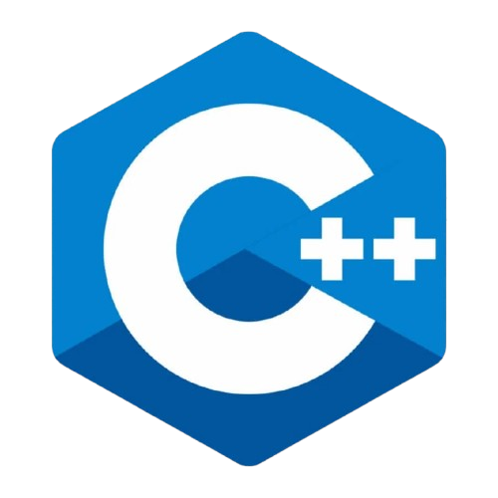
By Parthasarathi Swain

Slide 2

C++ Character Set
The C++ character set includes all characters used to write valid C++ programs. It's similar to learning alphabets before writing English sentences.
Letters:
Uppercase: A-Z
Lowercase: a-z
Digits:
0-9
Special Symbols:
+ - * / = < > ! % ^ & | ~ ? : ; , . # ( ) { } [ ] \\ \" \'
Whitespace Characters:
Space, Tab (\t), Newline (\n)
Other Characters:
Escape sequences like \n, \t, \\, \', \"
www.opentechz.com

Slide 3
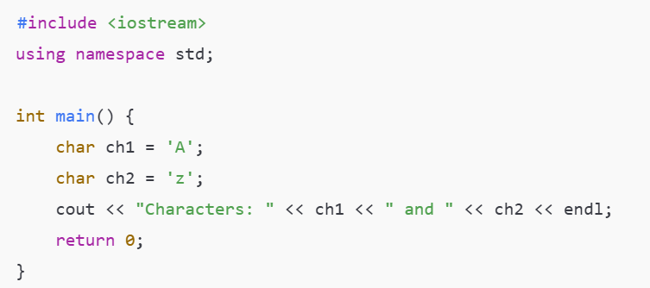

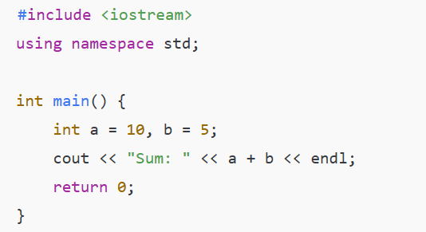

Example 1: Displaying character values
Example 2 : Using digits and symbols
www.opentechz.com

Slide 4
What are Escape Sequences in C++?
Escape sequences are special characters used to control output format. They begin with a backslash \ and are mainly used in printf() and cout.
Common Escape Sequences:
\n → New line
\t → Horizontal tab
\\ → Backslash
\" → Double quote
\' → Single quote
\a → Alert sound (beep)
\b → Backspace
\r → Carriage return (start of line)
\f → Form feed (page break)
www.opentechz.com

Slide 5
Example Program Using cout
#include <iostream>
using namespace std;
int main() {
cout << "Hello\nWorld\n\n";
cout << "Name:\tJohn\n\n";
cout << "Path: C:\\Program Files\\App\n\n";
cout << "She said: \"Welcome\"\n\n";
cout << "It's a good day.\n\n";
cout << "Beep sound\a\n\n";
cout << "Test\bX\n\n";
cout << "Start\rEnd\n\n";
cout << "Page 1\fPage 2\n";
return 0;
}
www.opentechz.com

Slide 6
Example Program Using printf
#include <cstdio>
int main() {
printf("Hello\nWorld\n\n");
printf("Name:\tJohn\n\n");
printf("Path: C:\\Program Files\\App\n\n");
printf("She said: \"Welcome\"\n\n");
printf("It's a good day.\n\n");
printf("Beep sound\a\n\n");
printf("Test\bX\n\n");
printf("Start\rEnd\n\n");
printf("Page 1\fPage 2\n");
return 0;
}
www.opentechz.com

Slide 7
What are Tokens?
In C++, tokens are the smallest building blocks of a program. They are like words in a sentence, giving structure and meaning.
1. Identifiers
Names given by the programmer to variables, functions, classes, etc. Example: total, getData(), Student
2.Keywords
Predefined, reserved words with special meaning. Example: int, float, if, while, return
3. Constants
Fixed values that do not change during execution. Example: 100, 3.14, 'A', "Hello“
4. Operators
Symbols that perform operations on variables/values. Example: +, -, *, /, ==, &&
5. Separators
Characters that separate tokens. Example: ,, ;, (), {}, []
www.opentechz.com

Slide 8
What is an Identifier?
An identifier is the name used to identify variables, functions, classes, objects, arrays, etc.
It is created by the programmer and is not predefined like keywords.
Rules
1.Must begin with a letter (A–Z or a–z) or an underscore (_)
Example: name, _value are valid
2.After the first character, digits (0–9) can also be used
Example: mark1, student_22
3.Cannot use C++ keywords as identifiers
Example: int, float, class cannot be used as variable names
4.No special characters allowed except underscore (_)
Characters like @, #, $, -, . are not allowed
5.Identifiers are case-sensitive
Example: Total and total are treated as two different identifiers
6.Should be meaningful and descriptive
Example: Use totalMarks instead of tm for better readability
7.No space is allowed in an identifier
Example: firstName is valid, first name is invalid
www.opentechz.com

Slide 9
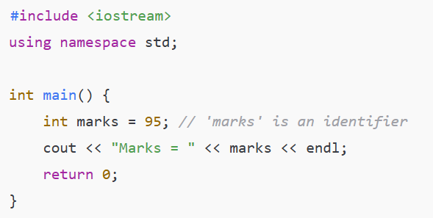

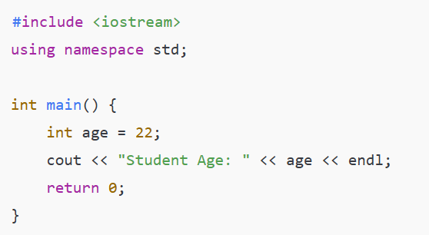

Example 1:
Example 2 :
www.opentechz.com
www.opentechz.com

Slide 10
What are Keywords?
Keywords are reserved words in C++.
Each keyword has a specific meaning and function in the language.
They cannot be used as identifiers (like variable or function names).
Total Keywords in C++ (C++17 Standard):
95 keywords in total
73 core keywords
18 from updates (C++11, C++14, C++17)
4 alternative tokens (e.g., and, or, not)
Category | Keywords
Data Types | int, float, double, char, bool, void
Control Flow | if, else, switch, case, default, goto
Loops | for, while, do, break, continue
Access Specifiers | public, private, protected
OOP Related | class, struct, union, this, virtual, new, delete
Exception Handling | try, catch, throw
Others | return, const, static, sizeof, typedef
Important Notes:
Case-sensitive → Int is not the same as int
Can not use keywords as
www.opentechz.com

Slide 11
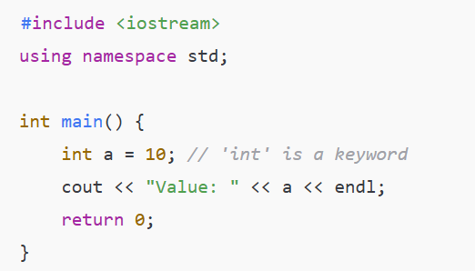

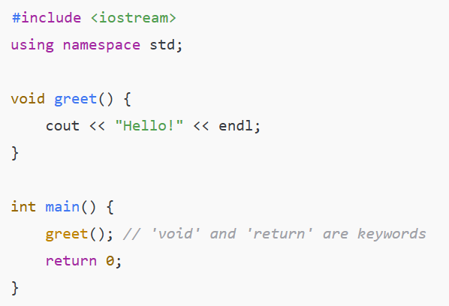

Example 1:
Example 2 :
www.opentechz.com
www.opentechz.com

Slide 12
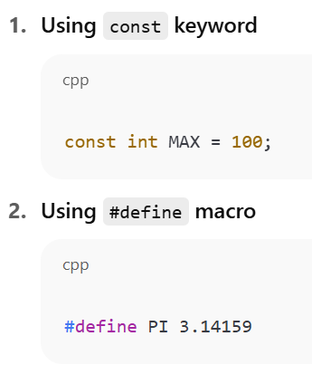
What is a Constant?
A constant is a fixed value that does not change during the execution of a program.
Types of Constants:
Ways to Declare Constants:
Integer Constants
Whole numbers without decimal
Example: 100, -25
Floating-Point Constants
Numbers with decimal points
Example: 3.14, -0.001
Character Constants
A single character enclosed in single quotes
Example: 'A', '9'
String Constants
A sequence of characters enclosed in double quotes
Example: "Hello", "C++ Programming"
Boolean Constants
Represents logical values
Example: true, false
www.opentechz.com

Slide 13
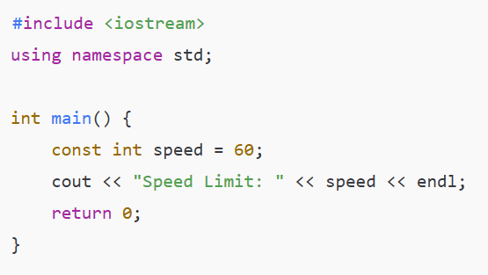

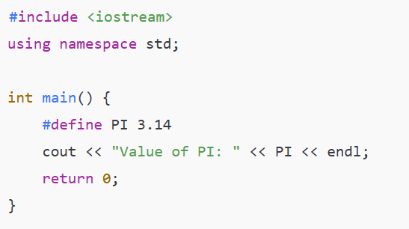

Example 1:
Example 2 :
www.opentechz.com
www.opentechz.com

Slide 14

Thank You

